Slide 1


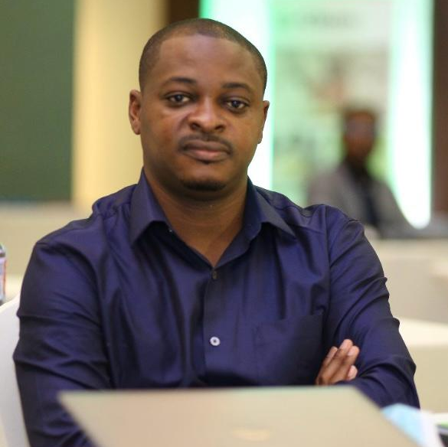
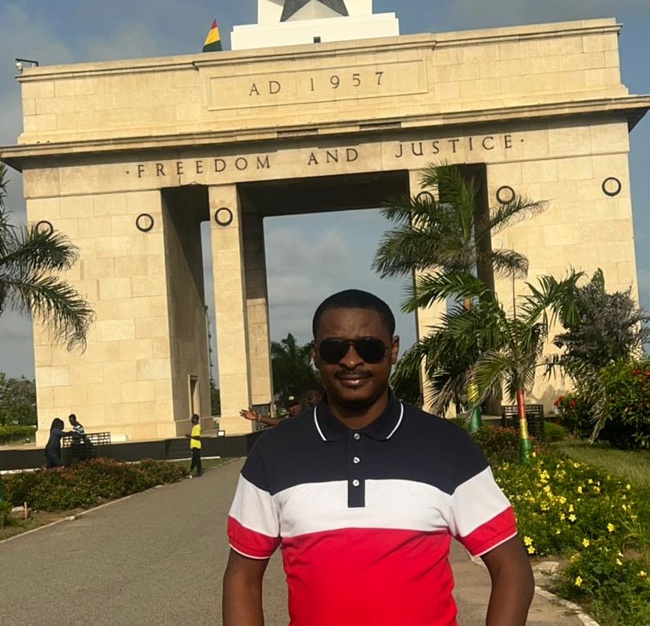
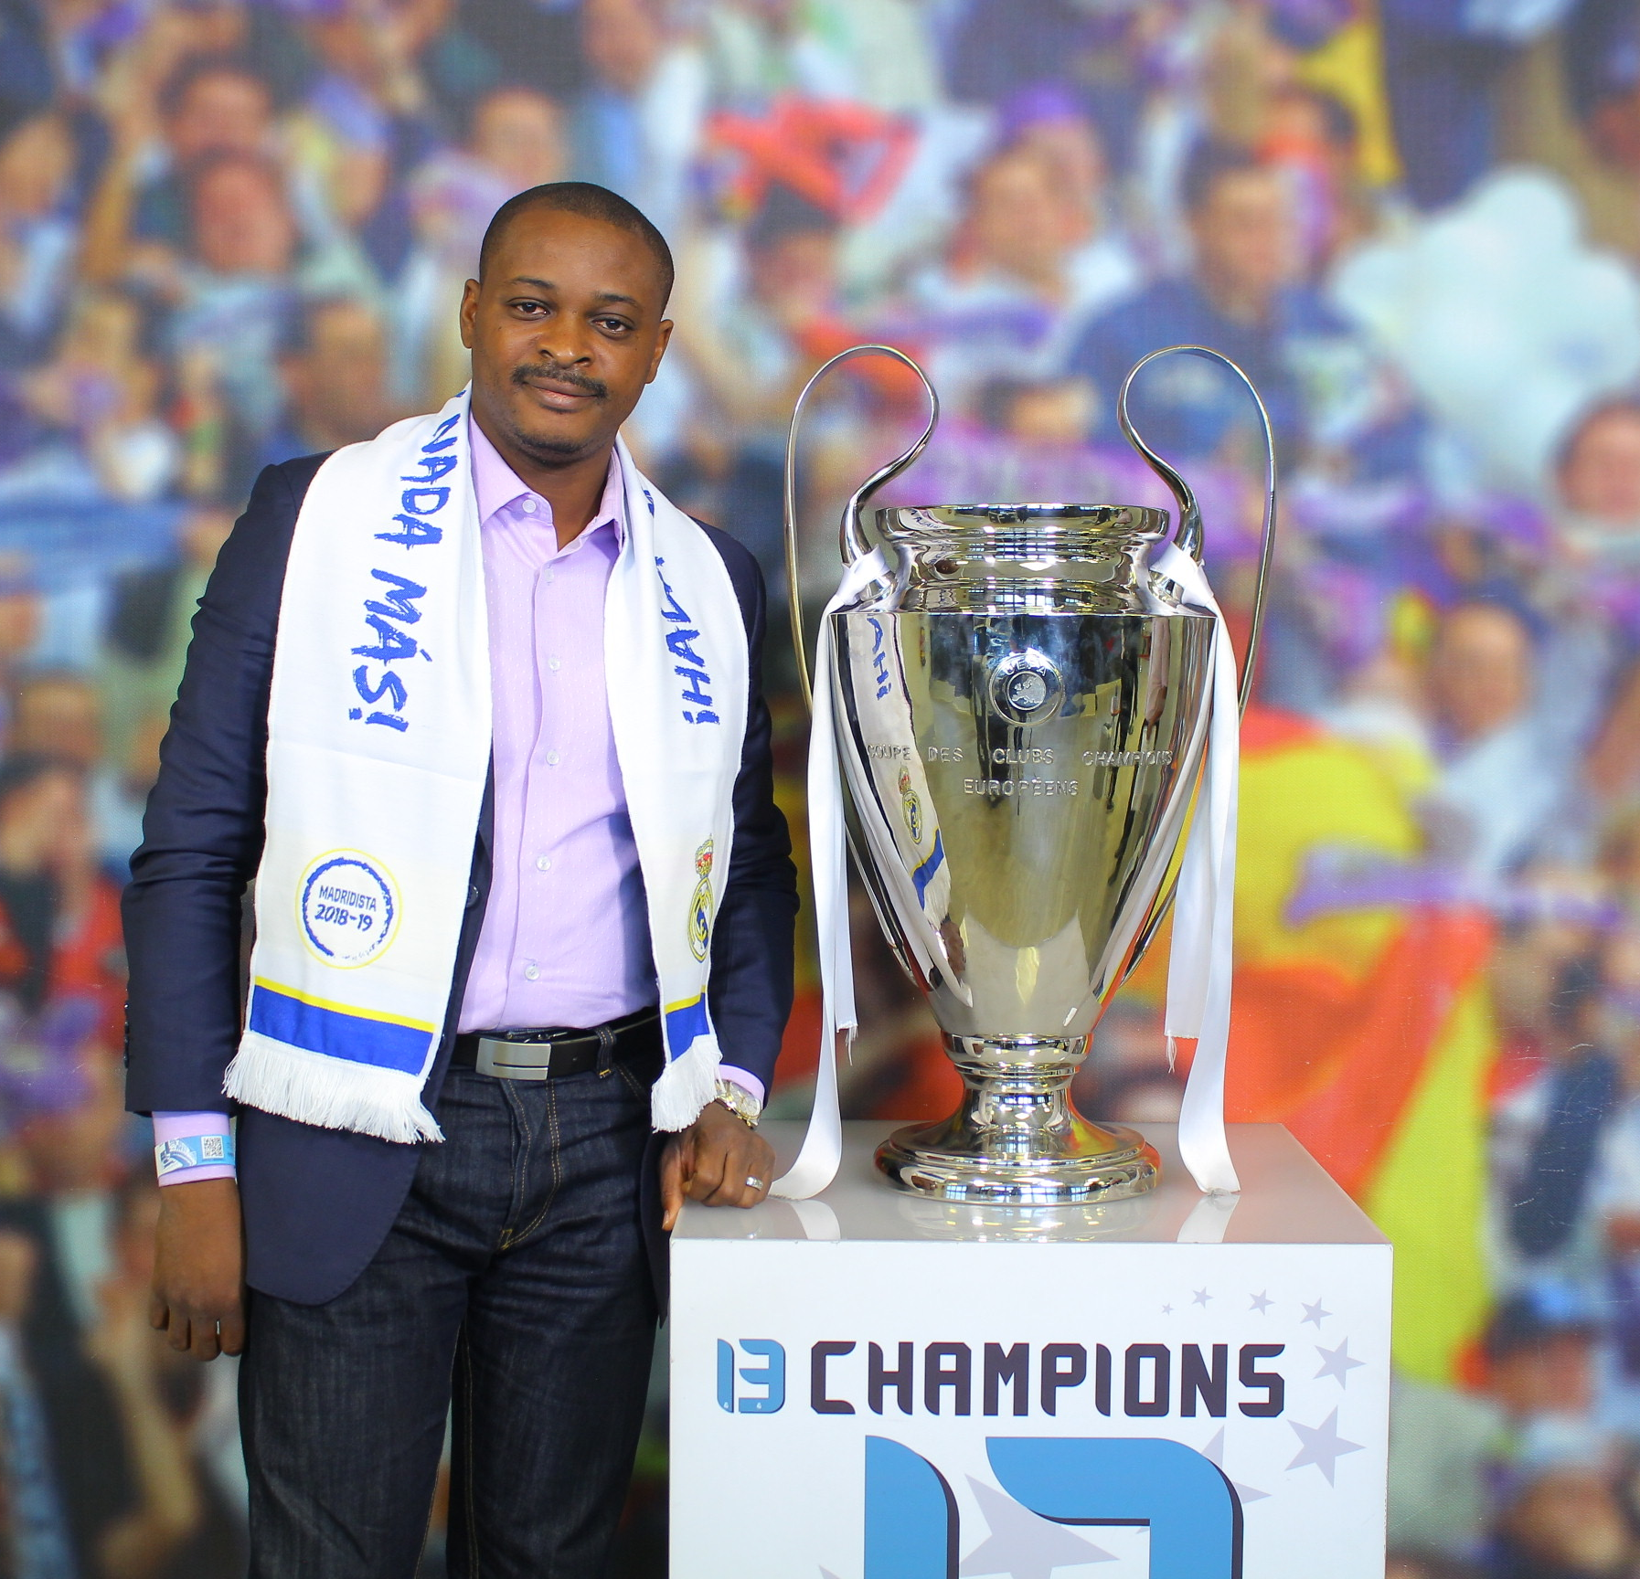
Getting to Know Me
Work
Personal
My role
FINANCE MANAGER
Significant others / family members / furry friends in my life
Wife and Kids
Tenure in ofi/Olam
6.5 YEARS
How I enjoy spending my free time
Read a lot, play football and travel to discover other cultures.
Previous companies I have worked at
ADITYA BIRLA GROUP/ASHOK LEYLAND WEST AFRICA/FLUDOR COTE D’IVOIRE
My favorite / comfort food
Rice with palm soup
Why I joined ofi/Olam and what keeps me here?
I joined OFI for its ability to offer me a very enriching working environment and also the challenges to overcome.
My favorite song
"Rumba" Congolese song
Issa Pale
‘ISSA’
Thirst for knowledge and sharing
This is me outside work, doing stuff I enjoy in my life …

